Slide 1
Human Gender Identification and Age Estimation Using Metabolomics Data
BIL 496
Final Presentation
Zafer Altay
Project Mentor: Doç. Dr. Habil KALKAN
March 2022

Slide 2
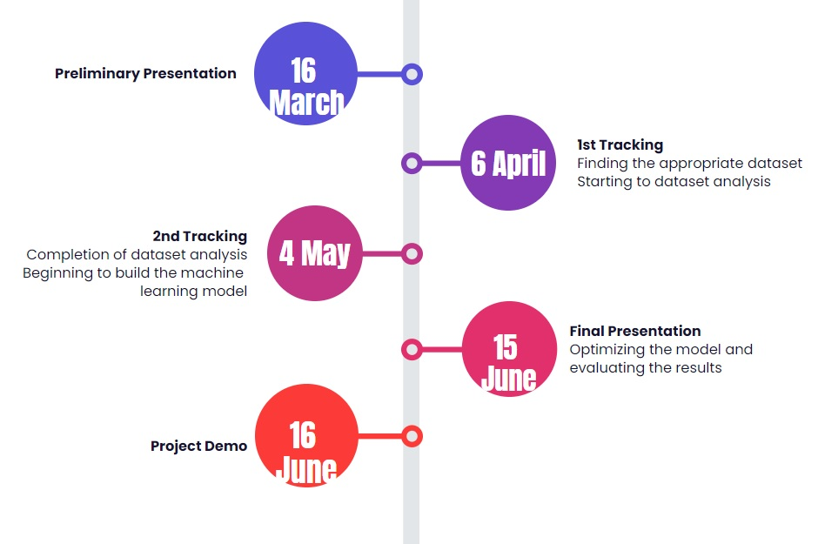
Timeline

Slide 3
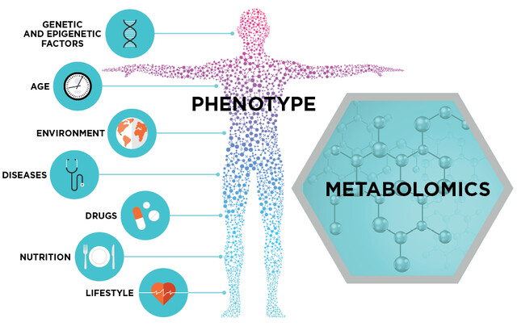
Project Review
Metabolomics Data Analysis
Metabolomic
Metabolite
Urine
Gender Identification
Disase Relation

Slide 4
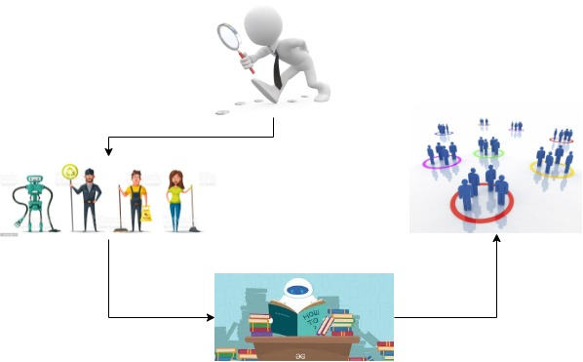
Project Design Plan
Find Dataset
Data PreProcessing
Build Model and Try ML Algorithm
Get Result

Slide 5
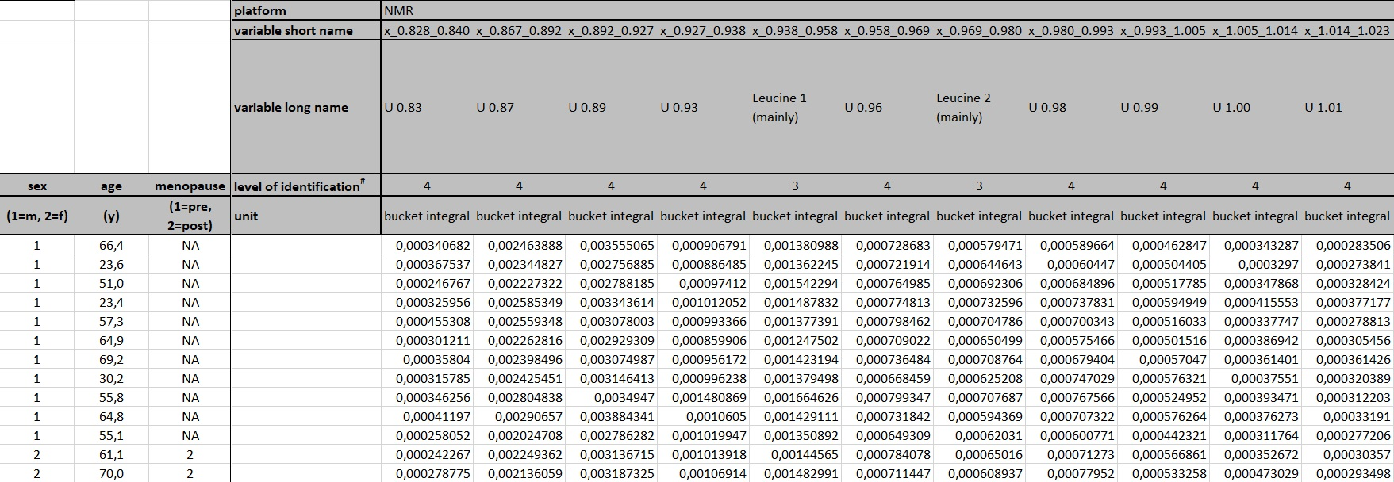
Dataset Details
172 Men
129 Women
18-80 Aged
528 Urine Metabolites

Slide 6
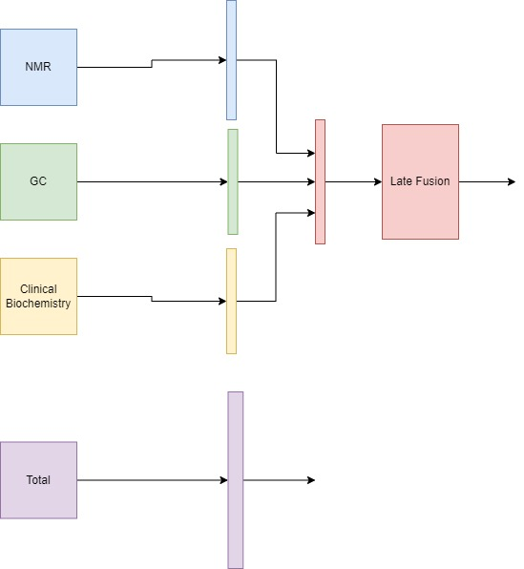
Build Model and Try
NMR-GC-CB
NMR-GC
NMR-CB
GC-CB

Slide 7
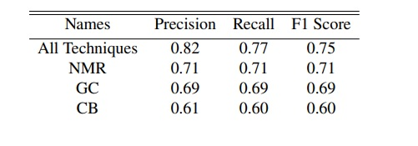
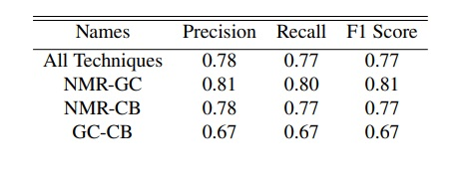
Results- Gender Identification

Slide 8
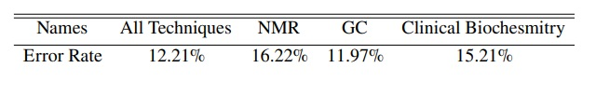
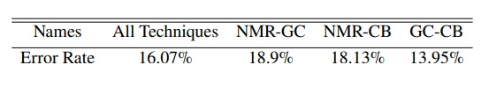
Results- Age Estimation

Slide 9
Success Criterias
For gender identification at least 75% success rate (81% NMR-GC)
Error rate of less than 20% in age estimation (%11.97 GC)
Model training time should be under 5 minutes for age – under 60 seconds for gender (Gender Model Passed)
For both methods, the success rate of the final model should be 10% better than first trial of the developed model( from 73% to 81% for gender || from 18.3% to 11.97% for age)

Slide 10
Resources
https://stringfixer.com/tr/Metabolomics
https://www.metaboanalyst.ca/docs/Format.xhtml
https://www.metabolomicsworkbench.org/
https://hmdb.ca/
https://pubmed.ncbi.nlm.nih.gov/?term=%22Metabolomics%2Fmethods%22%5BMAJR%5D&page=2

